Slide 1




Health Data Commons as a catalyst for UHC

Slide 2
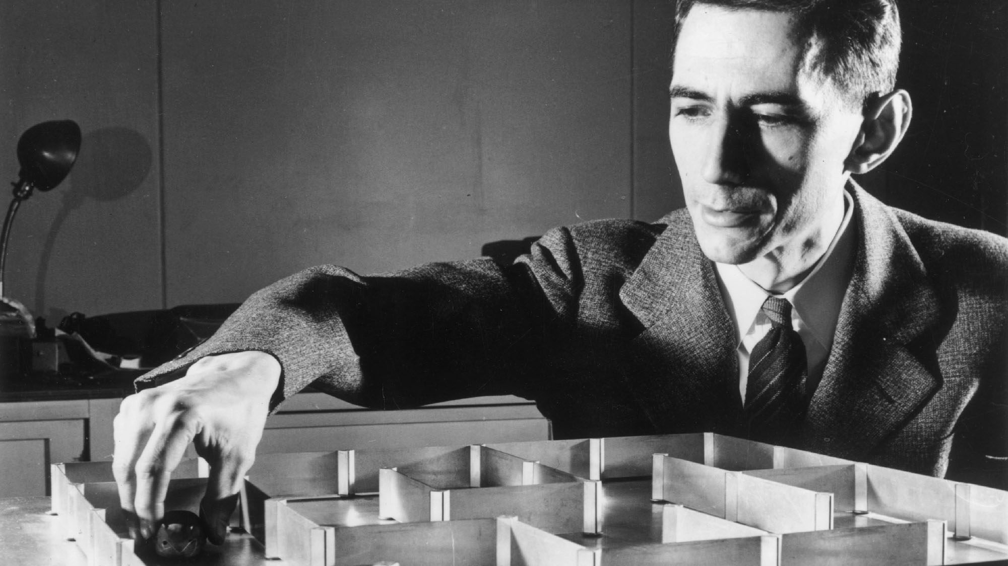
Part I A bird’s-eye view of digital technologies
Tip: watch The Bit Player

Slide 3



The landscape of digital technologies
The Silicon Engine
How computers have come so powerful
How algorithms have made computers more useful
How this is relevant for digital health
The Networking Engine
How the internet and mobile networks came to be
How important standards are for digital networks
How this is relevant for digital health
The Storage Engine
How storage has increased over time
How digitized data has made powerful algorithms possible
How data platforms are relevant for digital health
Source: Computer History Museum

Slide 4
The landscape of digital technologies
The Silicon Engine
How computers have come so powerful
How algorithms have made computers more useful
How this is relevant for digital health
The Networking Engine
How the internet and mobile networks came to be
How important standards are for digital networks
How this is relevant for digital health
The Storage Engine
How storage has increased over time
How digitized data has made powerful algorithms possible
How data platforms are relevant for digital health
Source: Computer History Museum

Slide 5
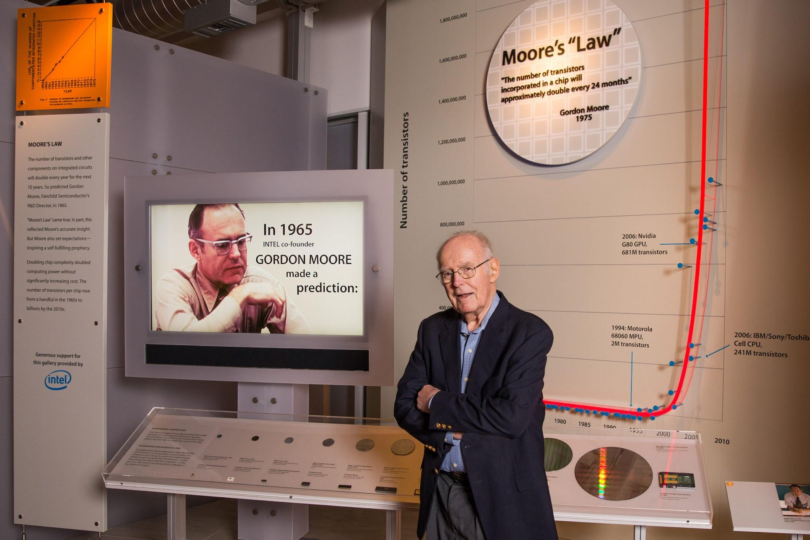
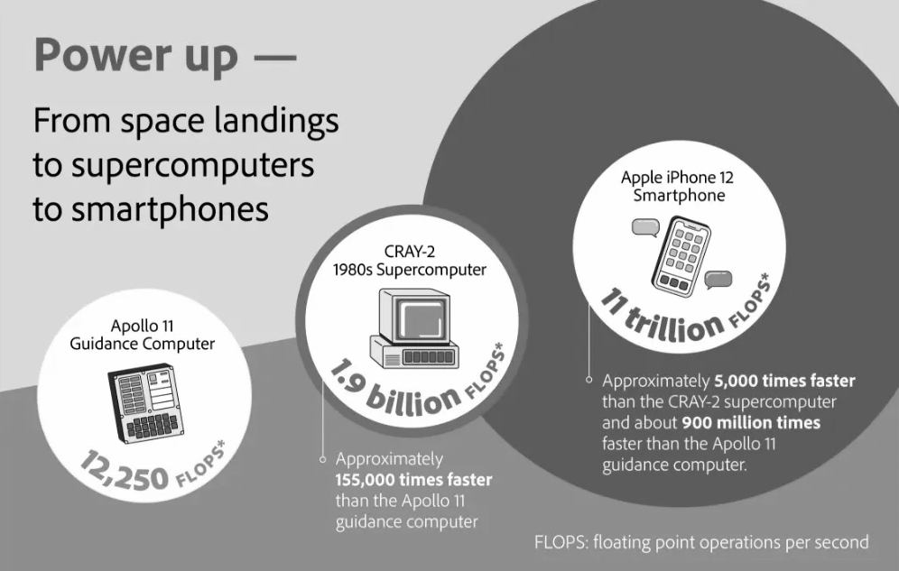
In memoriam: Gordon Moore (1929 – 2023)

Slide 6
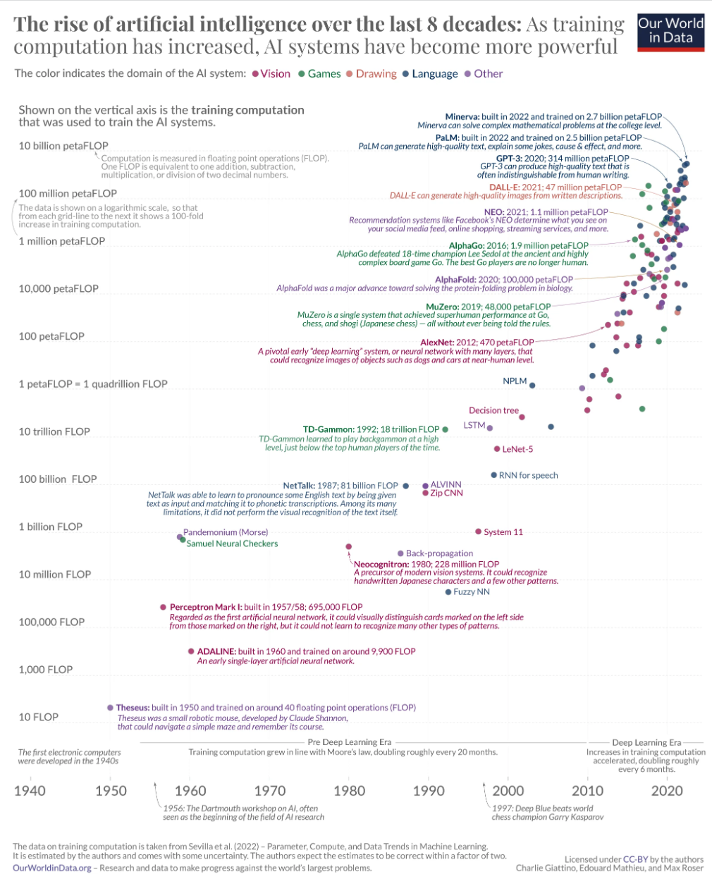
AI is not intelligent (yet), it is very powerful though
compute capacity of modern smartphone
Source: Our World in Data blogpost

Slide 7
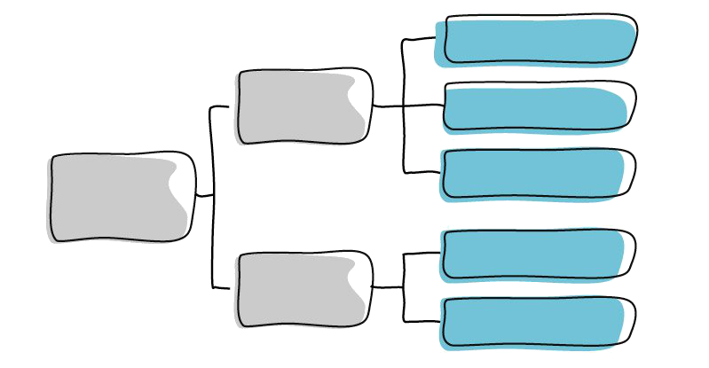
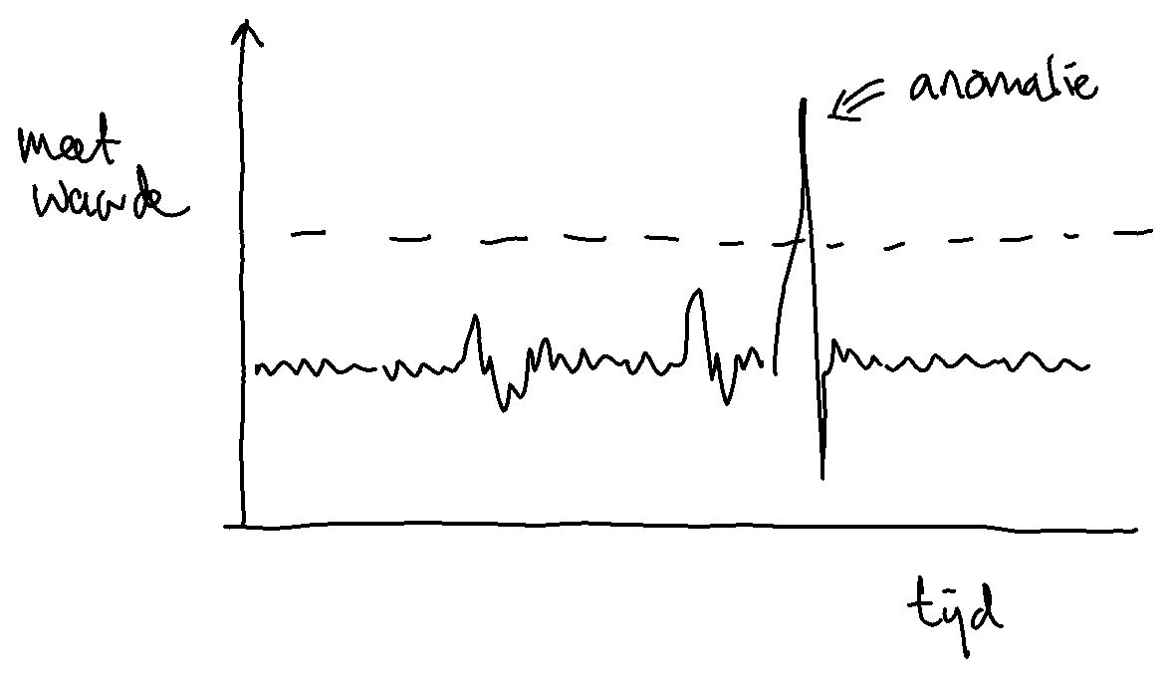
Types of algorithms
rule-based | machine learning
expert system | decision tree, neural network
threshold values | autocorrelations

Slide 8
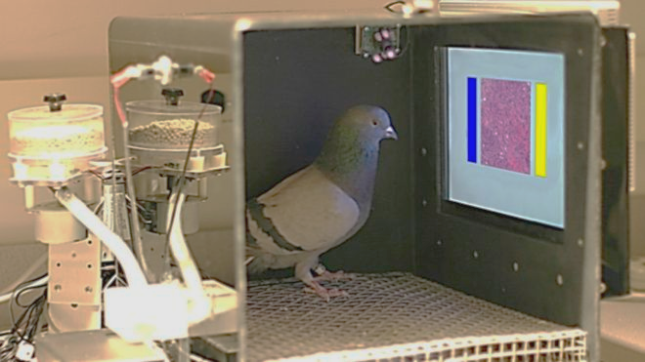
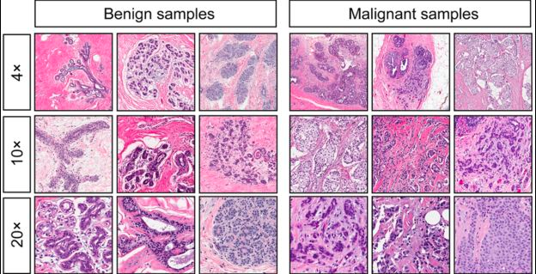
AI is not magic, pigeons can do it, too
https://journals.plos.org/plosone/article?id=10.1371/journal.pone.0141357

Slide 9
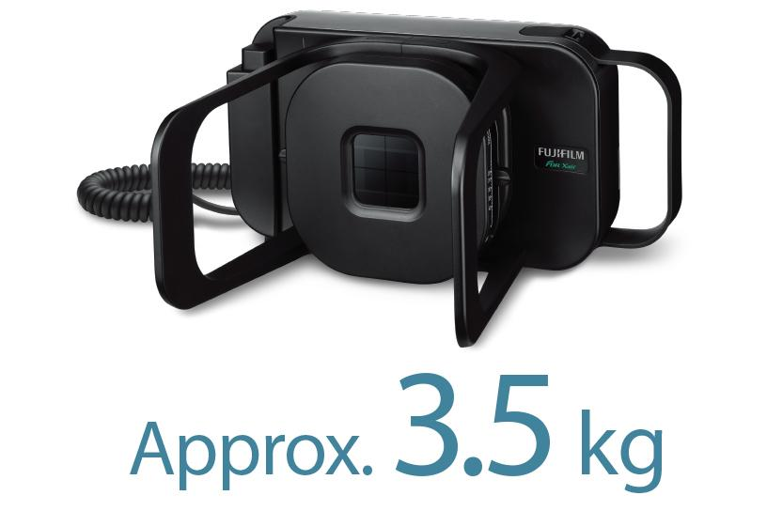
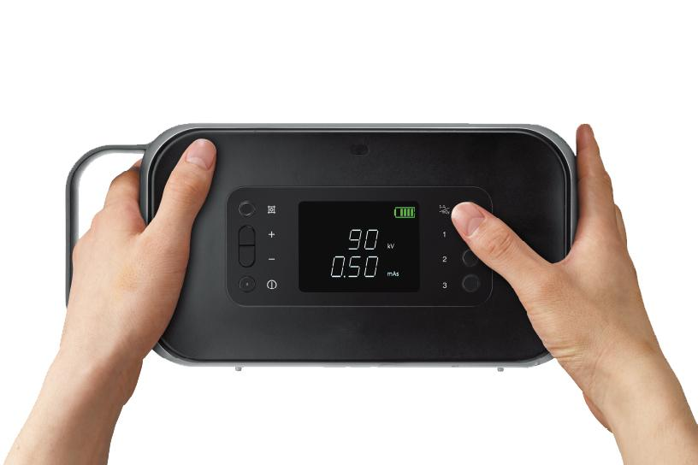
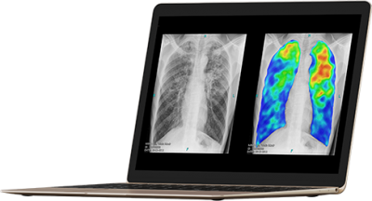
Portable AI for diagnostics is available
“There is a huge radiology gap, and a report from WHO indicates that two-thirds of the world’s population of over five billion people do not have or have less access to a radiologist and radiologic diagnostic support tools,” -
Mustapha Zaidan, co-founder Chestify
Current state of technology:
Portable X-ray facilities are being tested in various low-resource settings
Laptop-based AI can diagnose diseases reliably, e.g. tuberculosis
Sources: Chestify AI, field study South Africa, website Fujifilm, website Thirona.

Slide 10
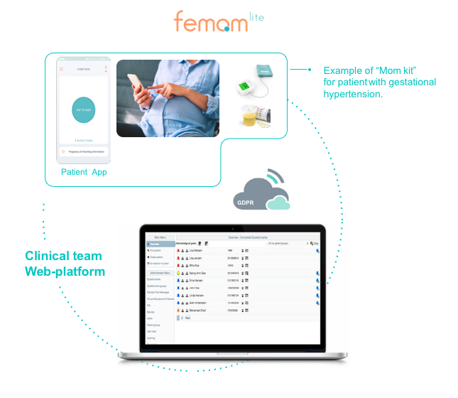
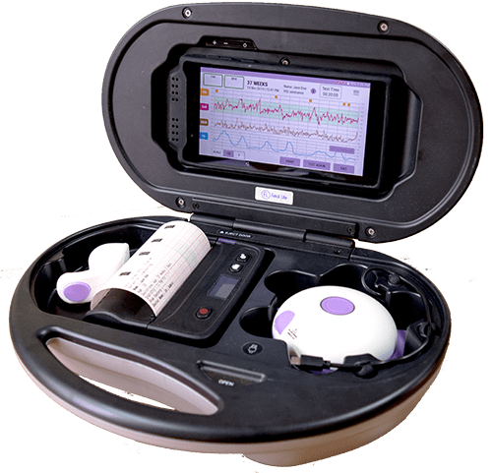
Remote fetal monitoring
WHO technology assessment:
Different commercial products available that comply with WHO technical specifications for “Foetal Cardiac Monitor”
Readiness level 9, commercially available in India, undergoing testing in Ghana (amongst others)
More evidence being required before proceeding (economic, improved outcomes, durability)
Sources: website innaccel, website bio-rithm, WHO report innovative health technologies for low-resource settings.

Slide 11
The landscape of digital technologies
The Silicon Engine
How computers have come so powerful
How algorithms have made computers more useful
How this is relevant for digital health
The Networking Engine
How the internet and mobile networks came to be
How important standards are for digital networks
How this is relevant for digital health
The Storage Engine
How storage has increased over time
How digitized data has made powerful algorithms possible
How data platforms are relevant for digital health
Source: Computer History Museum

Slide 12
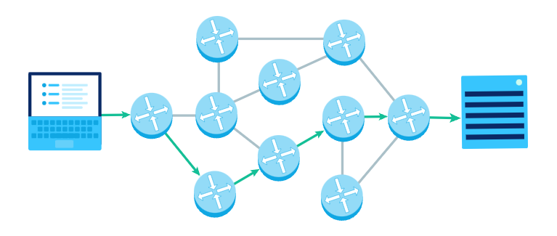
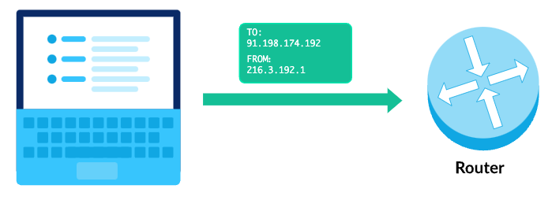
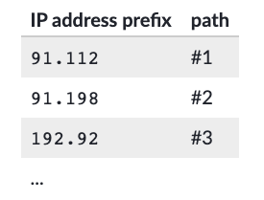
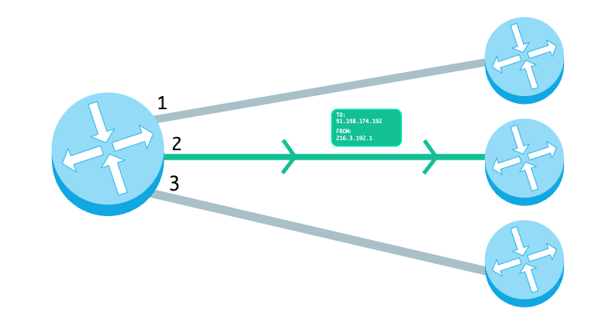
The Internet: distributed networking
Distributed networks are:
Resilient: fewer single points of failure
Scaleable: allow for gradually extending the network
Efficient: work is distributed over many nodes
Source: Khan Academy - tutorial Internet routing

Slide 13
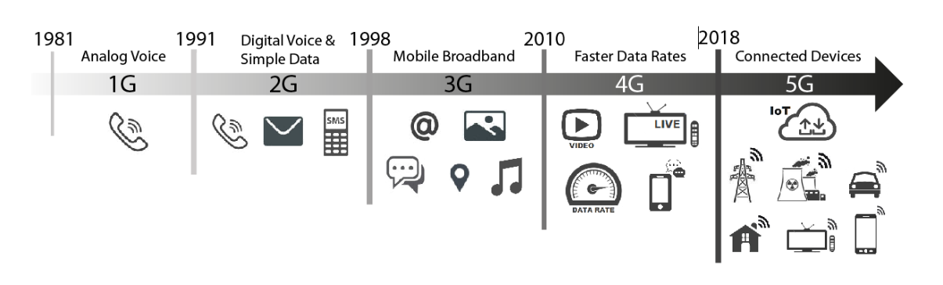
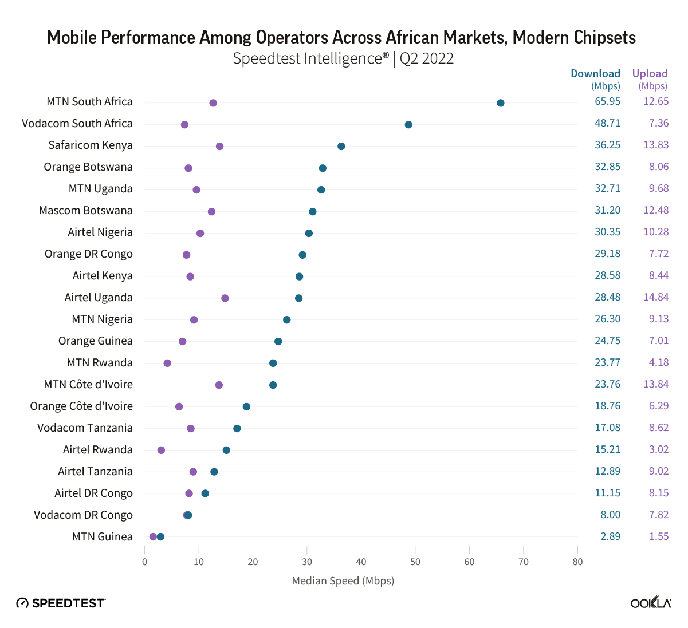
Evolution of mobile network speeds
Sources: the role of 5G technologies (research paper), Ookla speedtest Africa

Slide 14

How did the internet become of ubiquitous?
Application layer: apps, email, video conferencing
Minimal protocols
Internet protocol
Sources:
https://cacm.acm.org/magazines/2019/7/237714-on-the-hourglass-model/abstract, https://phys.org/news/2011-08-internet-architecture-hourglass-future.html,
Physical layer:
Mobile, fibre, satellite network, cable, DSL

Slide 15
The landscape of digital technologies
The Silicon Engine
How computers have come so powerful
How algorithms have made computers more useful
How this is relevant for digital health
The Networking Engine
How the internet and mobile networks came to be
How important standards are for digital networks
How this is relevant for digital health
The Storage Engine
How storage has increased over time
How digitized data has made powerful algorithms possible
How data platforms are relevant for digital health
Source: Computer History Museum

Slide 16
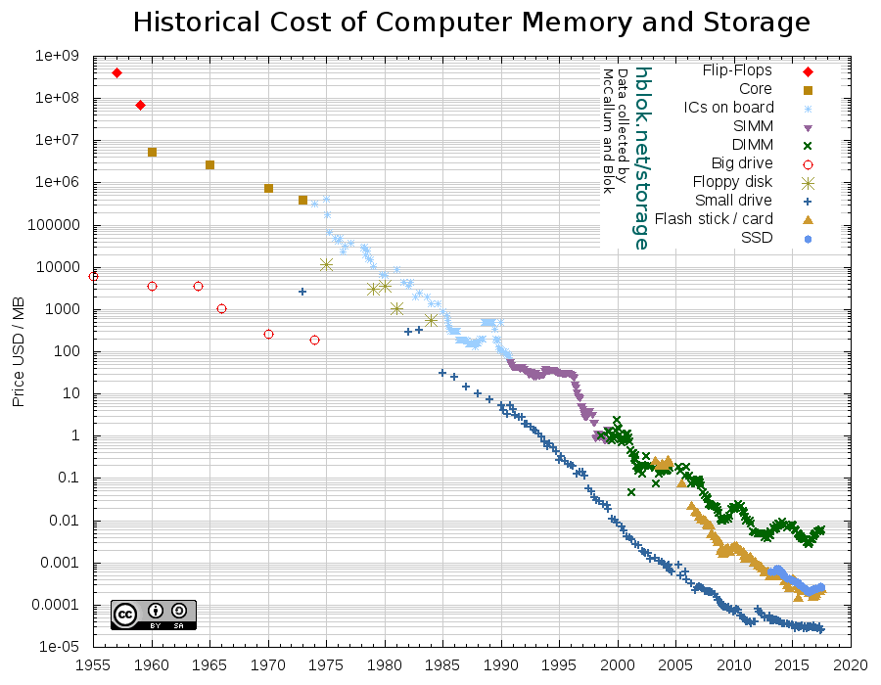
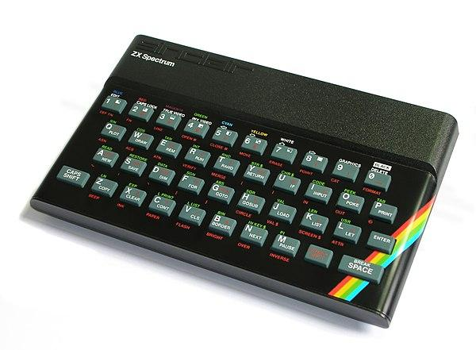
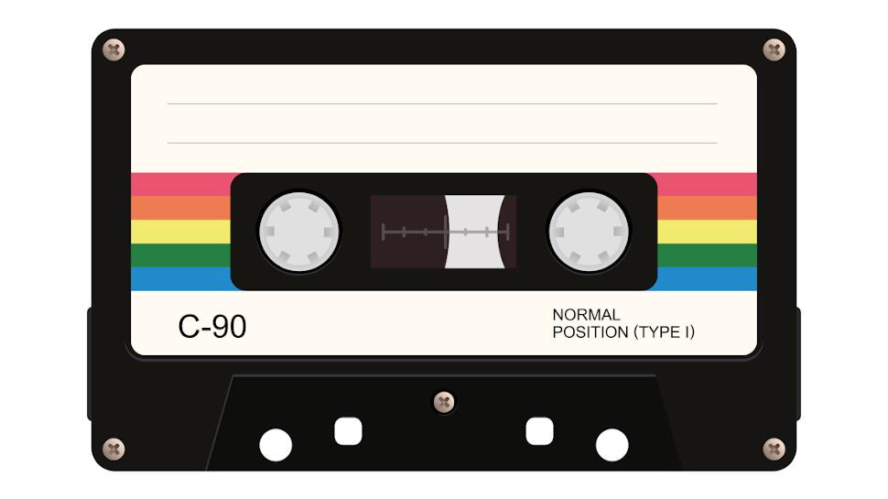
Storage has become 10x cheaper every 10 years
1982: ZX Spectrum - 16 KB RAM
1982: cassette tapes
60KB per 15 minutes
Source: https://hblok.net/blog/posts/2017/12/17/historical-cost-of-computer-memory-and-storage-4/

Slide 17
From application-centric to data-centric
Application-centric | Data-centric
Data are locked in siloed applications | Data are a shared resource with a longer lifetime than applications
Costly to make changes | Affordable to make changes
New projects require data migrations | New projects connect to existing data stations/stores
Data are not standardized, variety of formats, structures, meaning and terminology | Data are standardized, integrated, have a well-defined meaning and are (re-)used from a shared source in the required format
Data integration amounts to 35% to 65% of total IT spend | Data integration almost comes for free
Costly or impossible to integrate external data with internal data | External data integration is included by design
Source: http://datacentricmanifesto.org/principles/

Slide 18
From digital platforms to data platforms
Characteristic | Digital platforms (application-centric) | Data platforms (data-centric)
User groups | Developers Consumers | Data consumers Data owners/custodians Solution providers
Object of openness | Software/hardware modules | Data, aggregated data, trained models Data analytics modules
Ways to realize openness | Open source Open interfaces (APIs) | Data sharing through federation
Market consolidation | Strong network effects Dominant cross-industry platforms | Moderate network effects Fragmentation and heterogeneity
Risk of opening up | Loss of control, revenues, reputation, integrity | Loss of data sovereignty, privacy violation, confidentiality
Source: The Openness of Data Platforms

Slide 19


Conceptualizing data reuse with the hourglass model
Primary and secondary data reuse
Collaborative approach
Develop ecosystems that address patient needs
Develop new care concepts with service providers
Introduce enablers for people to exercise their personal data rights
Personal, health-related data of patients are the fundamental building blocks of a digitally-enabled healthcare ecosystem
Shared Health Record of patients is exchanged with minimal standards
Digital public goods and tech neutrality
Implement health data commons using digital public goods
Prevent vendor lock-in through technology-neutral reference implementations
physical
Virtual
Point of Care Service Providers

Slide 20

Part II Health Data Commons as a cornerstone of our new paradigm

Slide 21
What is a commons?
MATERIAL
Earth’s ecosystem oceans, atmosphere, forest, wildlife etc. | Urban commons ”Volkstuintjes”, sacco’s, citizen cooperatives
Human culture Language, education, spiritual teachings | Digital commons Wikipedia, open source software, urban digital twin
INHERITED
PRODUCED
IMMATERIAL

Slide 22
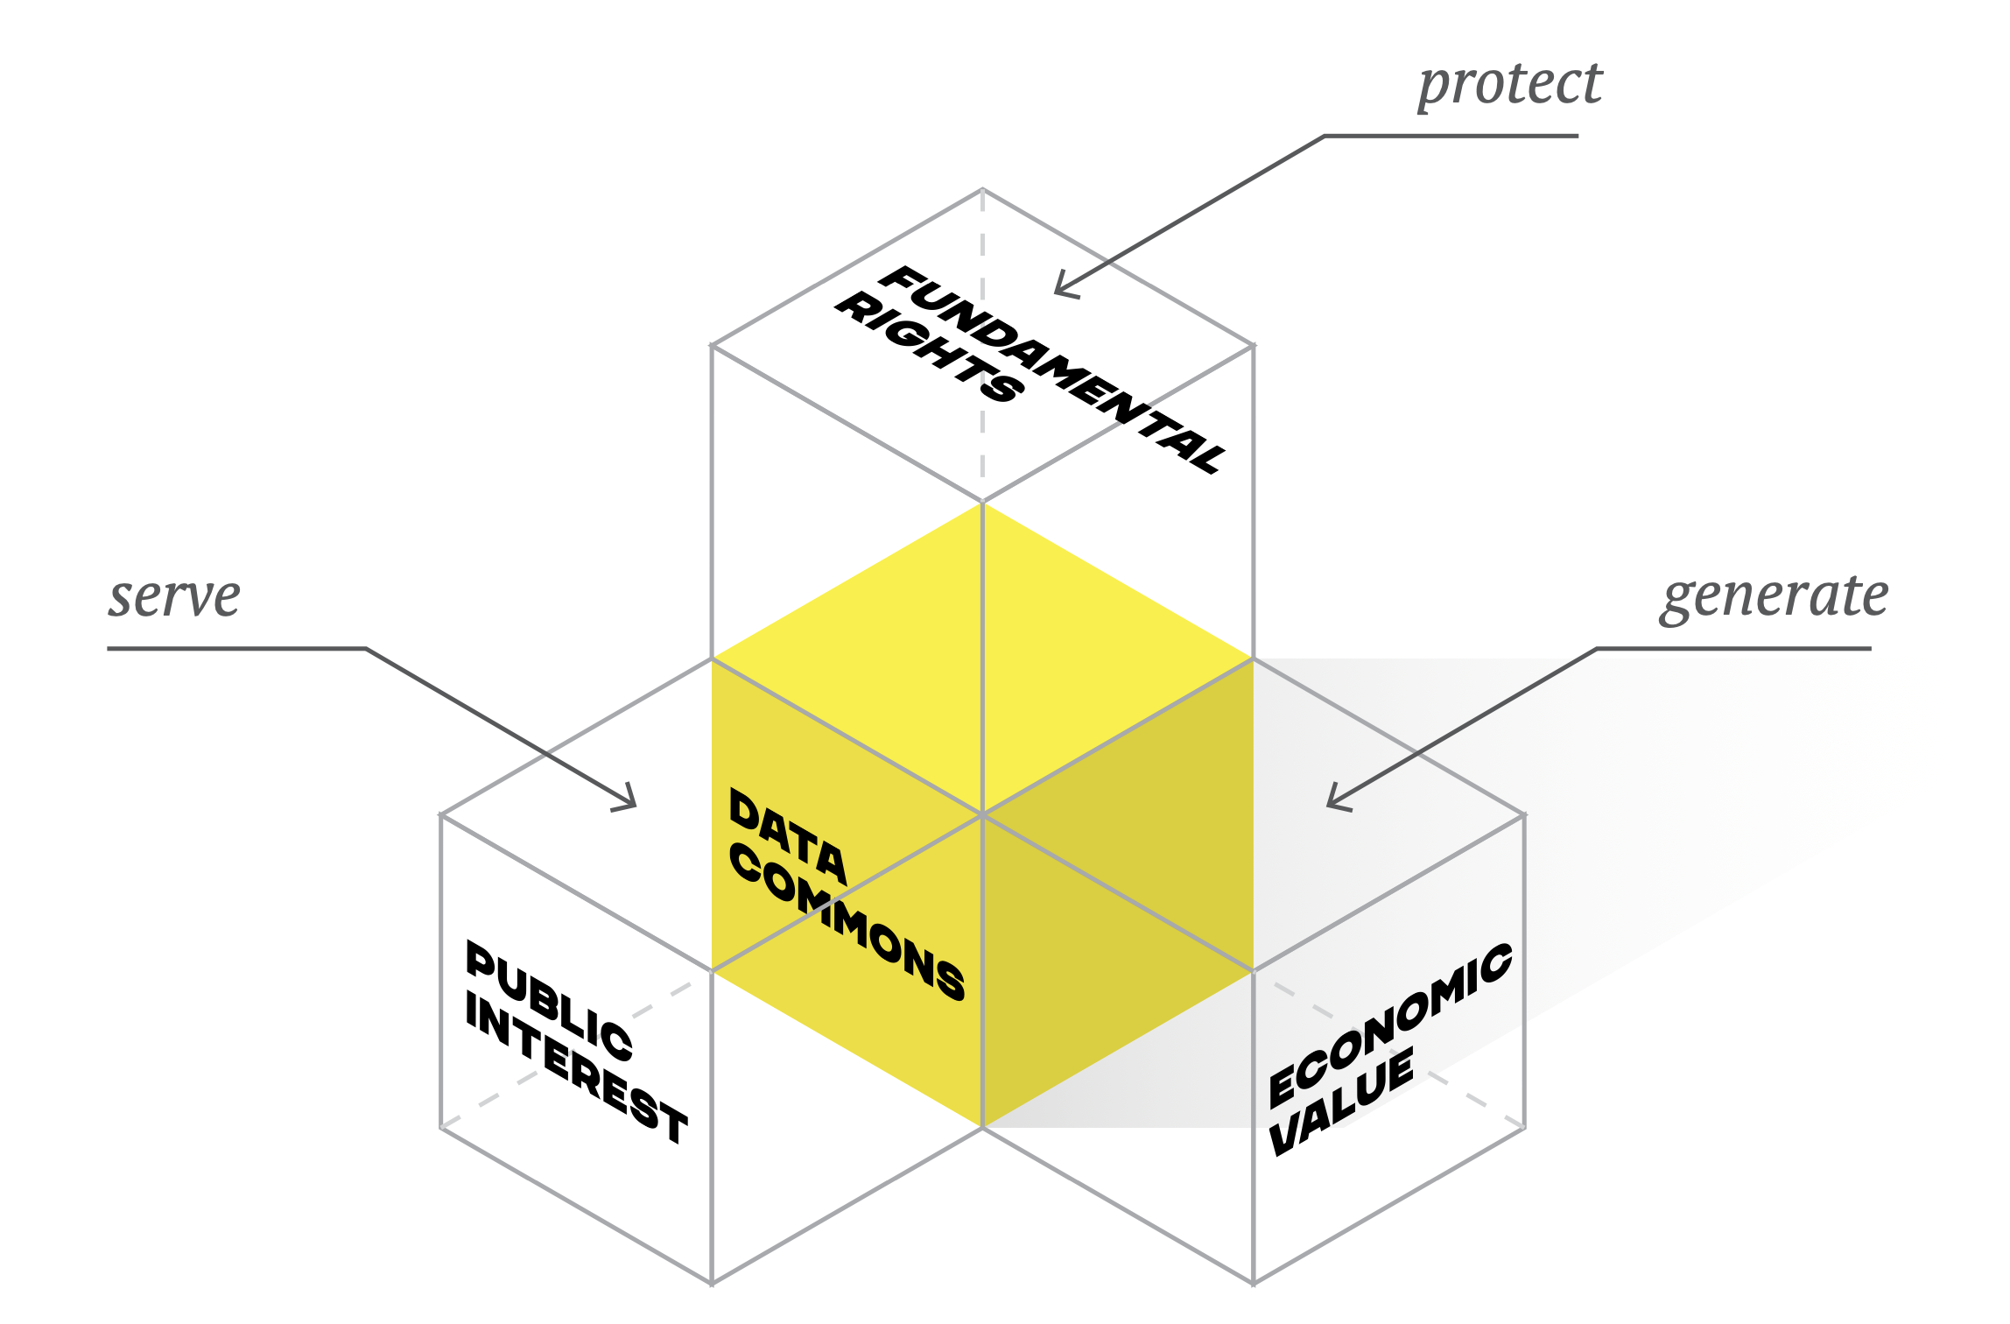
What is a data commons?

Slide 23

Our common task: Demonstrating governance model for health data sharing for the common good
Three pillars for governance of health data commons
1. Facilitating data use that creates significant public value
2.
Preventing and mitigating harm
3. Revenue sharing / “taxing” data use by third parties that generate little or no public value
Source: Barbara Prainsack et al., Data Solidarity (2022)

Slide 24
The hard part is the easiest: Our technical blueprint for a health data commons
COMMON
SERVICES
CR - Client Registry
FR - Facility Registry
HWR - Health Worker Registry
TS - Terminology Services
PC - Product Catalogue
BUSINESS
SERVICES
FIS - Finance & Insurance Service
HMIS - Health Mgt. Info. System
LMIS - Logistics Mgt. Info. Service
SHR - Shared Health Record
ANALYTICS & INTELLIGENCE SERVICES
Secondary re-sue of data
Based on OpenHIE*
One of the most widely used frameworks for implementing health data exchange in Africa
Standards-based, modular and with increasing number of implementations
Relevance today
Digital technologies have matured in the past decade, creating opportunities for effective and efficient implementations using digital public goods
Extend framework to support secondary re-use (next slide)
INTEROPERABILITY LAYER (IOL)
AC - Admin Console
ATNA - Audit Trail & Node Authentication
ILS - Interlinking and Routing Services, also known as Channels in the reference implementation
MEDIATORS - Pass-through, Adapter or Orchestration mediators
POINT OF SERVICE (POS) SYSTEMS
Different types of PoS systems are allowed, including EMR/EHRs (Electronic Health / Medical Record systems), mobile apps for patient or community workers and information systems for hospitals, pharmacies and laboratories.
Key defining characteristics are the workflows that are supported by the system (see examples).
* Similar architectures have been adopted in Nigeria, Kenya, Tanzania. For more details see OpenHIE documentation, review HIE in Africa.

Slide 25
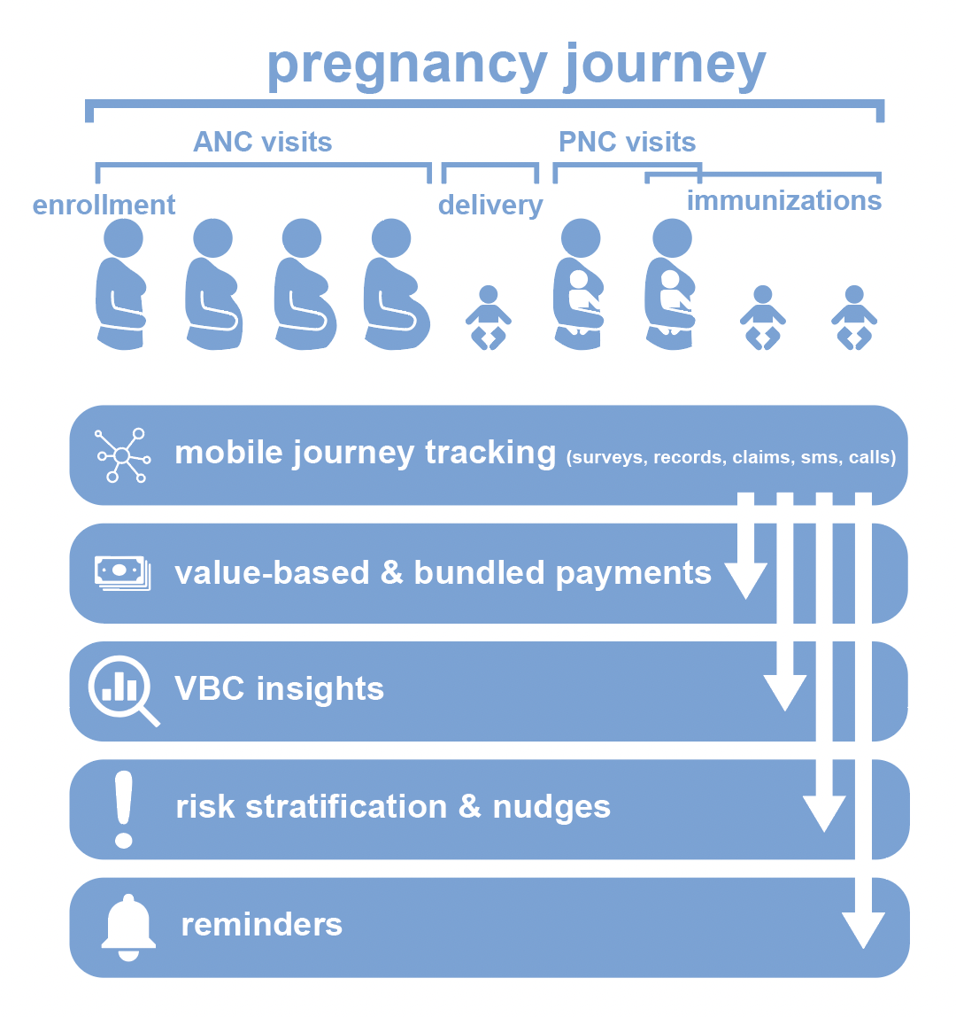
Demonstrating health data commons with MomCare

Slide 26






WHAT: Results technical demonstrators with MomCare Tanzania
PoS: Chain of Trust app functions as electronic medical record for MomCare programme
Interoperability: Demonstrator for FHIR translation to create ‘data station’ of shared health record for re-use
Business Services:
Automation of DHIS2 reporting based on shared health records
Implementation of Value Points Dashboard based on shared health records
Capability for plug-&-play publishing of dashboards into existing mobile web that is resilient to intermittent Internet connections
Analytics Services:
Configured analytics workbench (in-the-clear)
Pilot multi-party computation (MPC, in-the-blind)
COMMON
SERVICES
CR - Client Registry
FR - Facility Registry
HWR - Health Worker Registry
TS - Terminology Services
PC - Product Catalogue
BUSINESS
SERVICES
FIS - Finance & Insurance Service
HMIS - Health Mgt. Info. System
LMIS - Logistics Mgt. Info. Service
SHR - Shared Health Record
DS - Data Services (?!)
ANALYTICS & INTELLIGENCE SERVICES
Secondary re-sue of data
DHIS2 report
Shared Health Record
Value Points Dashboard
Analytics workbench
INTEROPERABILITY LAYER (IOL)
AC - Admin Console
ATNA - Audit Trail & Node Authentication
ILS - Interlinking and Routing Services, also known as Channels in the reference implementation
MEDIATORS - Pass-through, Adapter or Orchestration mediators
FHIR legacy mediator
POINT OF SERVICE (POS) SYSTEMS
Different types of PoS systems are allowed, including EMR/EHRs (Electronic Health / Medical Record systems), mobile apps for patient or community workers and information systems for hospitals, pharmacies and laboratories.
Key defining characteristics are the workflows that are supported by the system (see examples).
Chain of Trust app

Slide 27
Taking the lead in a coalition of the willing and explore potential ecosystem partners
Aim to achieve interoperability with existing programmes such as DHIS2, openIMIS
Partners such as Infospective can help demonstrate new care models
Opportunities for collaboration with insurance companies
Independent organization, for example universities, can act as custodian for governing secondary data re-use
Pharma industry, e.g. IQVIA, seeking real-world evidence
Possible funders for kick-starting data commons?
COMMON
SERVICES
BUSINESS
SERVICES
ANALYTICS & INTELLIGENCE SERVICES
Local authorities are key stakeholder, our aim is to help and accelerate implementation of interoperability layer and common services
INTEROPERABILITY LAYER (IOL)
POINT OF SERVICE (POS) SYSTEMS
Suppliers of PoS systems at community level, for example, Medtronic Spice, remote diagnostics
Suppliers of PoS systems at facility level, for example, AfyaRecod, Elephant, bahmni
Suppliers of PoS systems for pharmacies
Suppliers of PoS systems for laboaratories

Slide 28

Thank you for your time.

